Slide 1
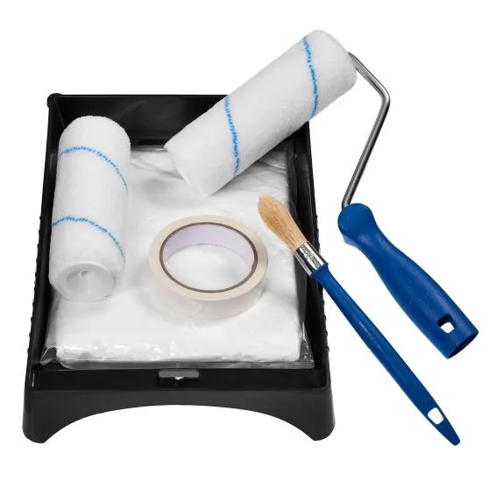
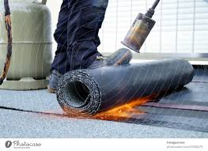
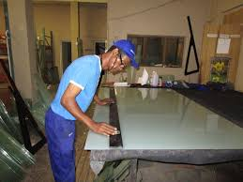
Waterproofing, Painting & Glazing

Slide 2
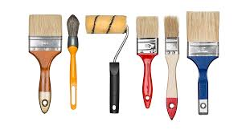
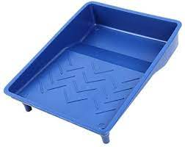
Basic hand tools.
1. Paint brushes and Rolers
- It is used for removing and replacing clamps.
2. Trays
- It is used to for fastening and loosing bolts and nuts.

Slide 3
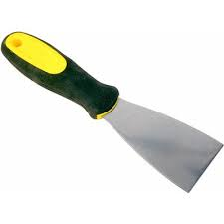
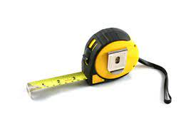
3. Scrapers
- It is used for fastening and loosing screws.
4 Measuring tape
- It is used for general hammering.

Slide 4
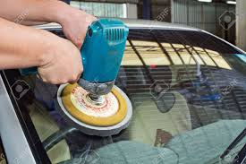
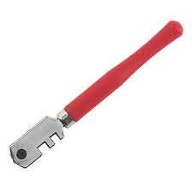
5.Glass polishers
- It is used for cutting pipes.
6. Glass cutter.
- It is used for fastening and loosening of bolts and nuts.

Slide 5
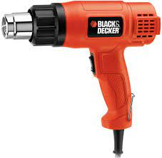
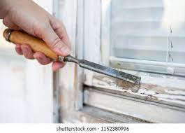
7. Hot air gun
- It is used for fastening and loosening of bolts, nuts and fittings.
8. Chisel
- It is used as a cutting tool..

Slide 6
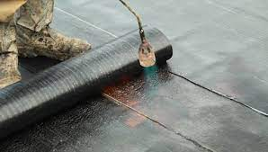
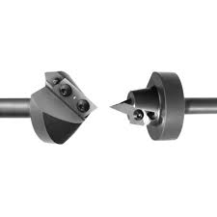
9. Blow torch
- It is used for heating of metals and pipes
10. Groove cutting tool
- It is used for cutting pipes.

Slide 7
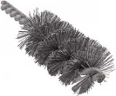
Basic hand tools. (continues)
13. Pipe brush
- It is used for cleaning of oxide films.
Feedback
Activity : Worksheet 1

Slide 8

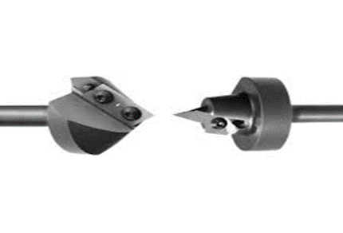


Kwa Thema Skills School
Subject : Maintenance Marks : 10
Grade : Year 2 Time : 30mins
Date :
Question:1
Name the following Hand and Power tools that are used in waterproofing, painting and glazing.
1.__________________ 2.______________________
3.___________________ 4. ______________________

Slide 9
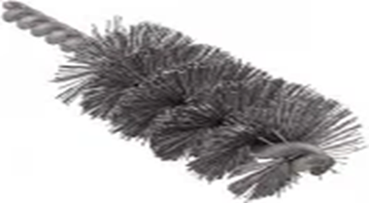
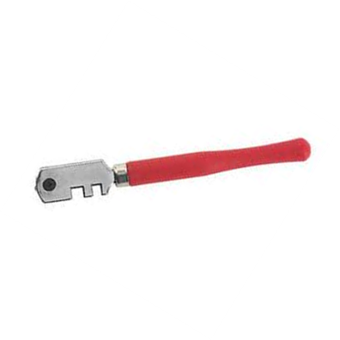




5. _________________ 6. ____________________
7. __________________ 8. ___________________
9. __________________ 10. ___________________
(10)

